Slide 1

House Rent Prediction

Slide 2
SUBMITTED BY
SRN | NAME
PES2UG20CS914 | PARTH SINGH
PES2UG20CS906 | DISHA SINGH D
PES2UG20CS901 | ARJUN VINAY AVADHANI

Slide 3
Problem Statement
Renting, also known as hiring or letting, is an agreement where a payment is made for the temporary use of a good, service, or property owned by another. In this Dataset, we have information on almost 4700+ Houses/Apartments/Flats Available for Rent with different parameters like BHK, Rent, Size, No. of Floors, Area Type, Area Locality, City, Furnishing Status, Type of Tenant Preferred, No. of Bathrooms, Point of Contact. On the basis of these indicators we are going to predict house rent values .

Slide 4
Problem Statement
In our Dataset, we have information on almost 4700+ Houses/Apartments/Flats Available for Rent with different parameters like BHK, Rent, Size, No. of Floors, Area Type, Area Locality, City, Furnishing Status, Type of Tenant Preferred, No. of Bathrooms, Point of Contact. The aim is to predict the rent of of a house using the above indicators.

Slide 5

Literature Survey
As part of our literature survey, we reviewed 6 research papers which are relatively similar to the aim of our problem statement.
Papers we did survey on ;​
1. Predicting the rental value of houses in Tanzania, Uganda and Malawi : Evaluations of hedonic pricing and ML approaches. 2. Housing Price Prediction via Improved ML techniques ​
3. Monitoring house rental price based on social media ​
4. Modelling house rent in atlanta metropolitan area using textual information and deep learning.
5. House Price Prediction using Random Forest Machine Learning Technique
6. House Price Prediction Using LSTM
Models used in each paper ;​
Paper-1 : Ridge regression, LASSO, Tree Regression, Bagging, Random Forest and Boosting.​
Paper-2 : XGBoost, LightGBM, Random Forest Technique.​
Paper-3 : Hedonic regression model with six different machine learning algorithms
Paper-4 : A combination of linear non linear and ensemble algorithms are used
Paper-5 : Random Forest ML
Paper-6 : Long Short Term Memory
We can apply most of the above models to our dataset.

Slide 6


APPLICATIONS
House rent prediction finds multiple applications in the real world . The value of rent depends on multiple factors and all of them need to be factored in , manually doing this is close to impossible and hence using MI algorithms we can efficiently predict the rent of any house
House rent prediction finds multiple applications in the real world . The value of rent depends on multiple factors and all of them need to be factored in , manually doing this is close to impossible and hence using MI algorithms we can efficiently predict the rent of any house

Slide 7
APPLICATIONS
The rental industry is a growing one and will continue to remain so . Factors influencing rental value keep changing and hence new MI algorithms help in accurate predictions with the trend and hence house rent prediction finds numerous applications

Slide 8
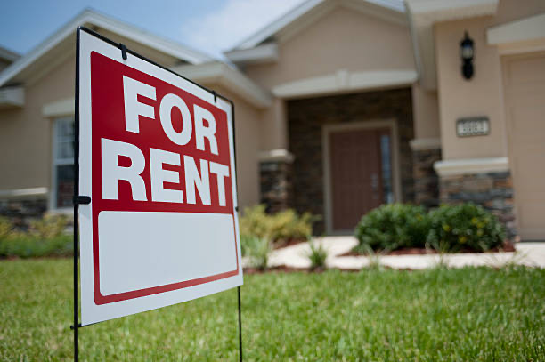
Meet Our Dataset
Housing in India varies from palaces of erstwhile maharajas to modern apartment buildings in big cities to tiny huts in far-flung villages.
There has been tremendous growth in India's housing sector as incomes have risen.
The Human Rights Measurement Initiative finds that India is doing 60.9% of what should be possible at its level of income for the right to housing.
Renting, also known as hiring or letting, is an agreement where a payment is made for the temporary use of a good, service, or property owned by another.
A gross lease is when the tenant pays a flat rental amount and the landlord pays for all property charges regularly incurred by the ownership.
Renting can be an example of the sharing economy.

Slide 9
Attributes in our dataset
Point of Contact
Furnishing Status
City
BHK
Rent
Area Locality
Size
Tentant Prefered
Floor
Area Type
Bathroom
City where the Houses/Apartments/Flats are Located
Whom should you contact for more information regarding the Houses/Apartments/Flats
Number of Bedrooms, Hall, Kitchen
Furnishing Status of the Houses/Apartments/Flats, either it is Furnished or Semi-Furnished or Unfurnished
Rent of the Houses/Apartment/Flats
Locality of the Houses/Apartments/Flats
House_Rent_Prediction|EDA|11_Models
Size of the Houses/Apartments/Flats in Square Feet
Houses/Apartments/Flats situated in which Floor and Total Number of Floors (Example: Ground out of 2, 3 out of 5, etc.)
Size of the Houses/Apartments/Flats calculated on either Super Area or Carpet Area or Build Are
Type of Tenant Preferred by the Owner or Agent
Number of Bathrooms

Slide 10
Approach
As stated earlier various MI algorithms can be used to predict the house rental values but according to our analysis we have found that compared to the other algorithms that we have used.
LightGBM which is a fast, distributed, high-performance gradient boosting framework that is based on the decision tree algorithm and is used for ranking, classification and many other machine learning tasks.
→ LightGBM splits the tree leaf-wise as opposed to other boosting algorithms that grow tree level-wise. It chooses the leaf with maximum delta loss to grow.
→ Since the leaf is fixed, the leaf-wise algorithm has lower loss compared to the level-wise algorithm.

Slide 11
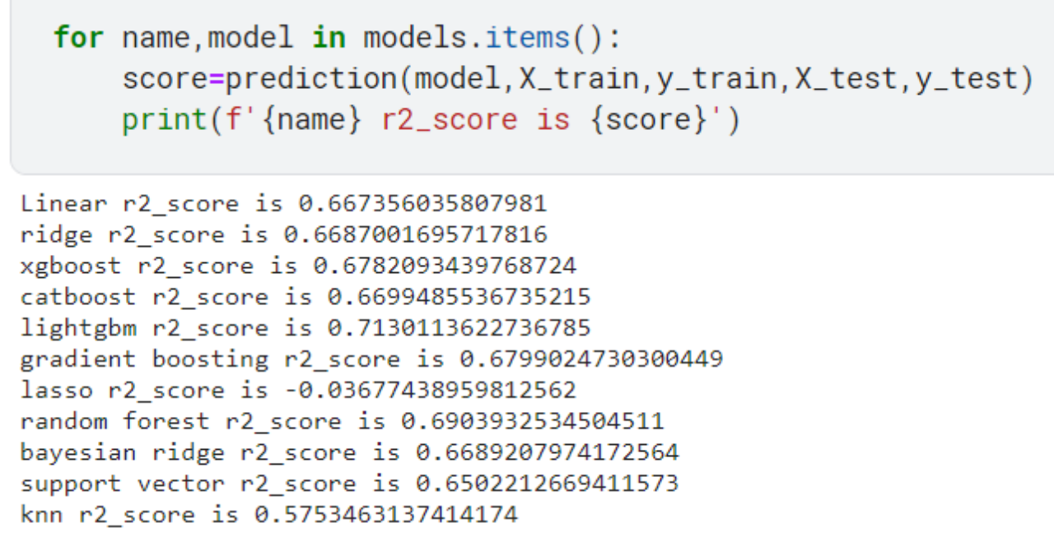
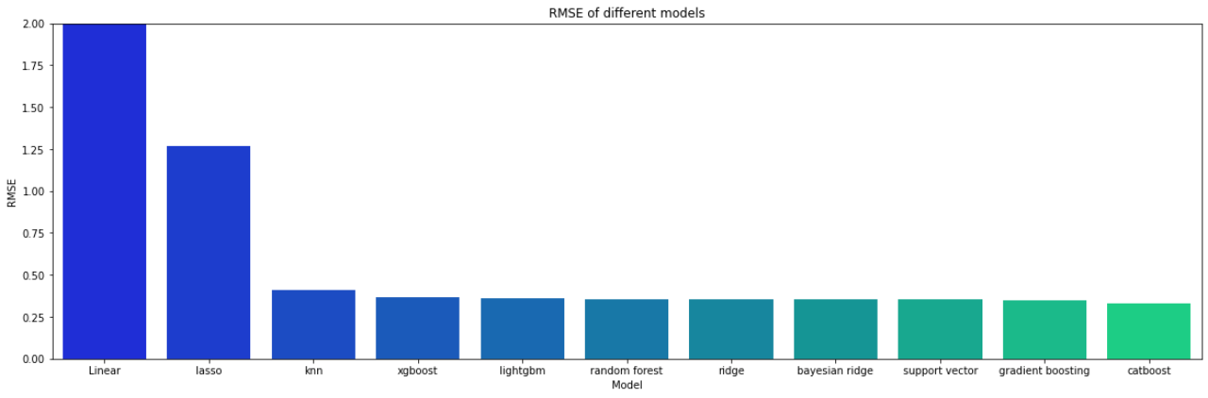
EVALUATION METHOD:
Evaluation metrics used in our project are R squared and Root mean squared error .
Using the Light gbm method we have found that:
1. The R squared value is greater than 0.71 which is higher compared to all the other tested models.
2. The RMSE value is found to be 0.358 which is lesser than all the other tested models

Slide 12

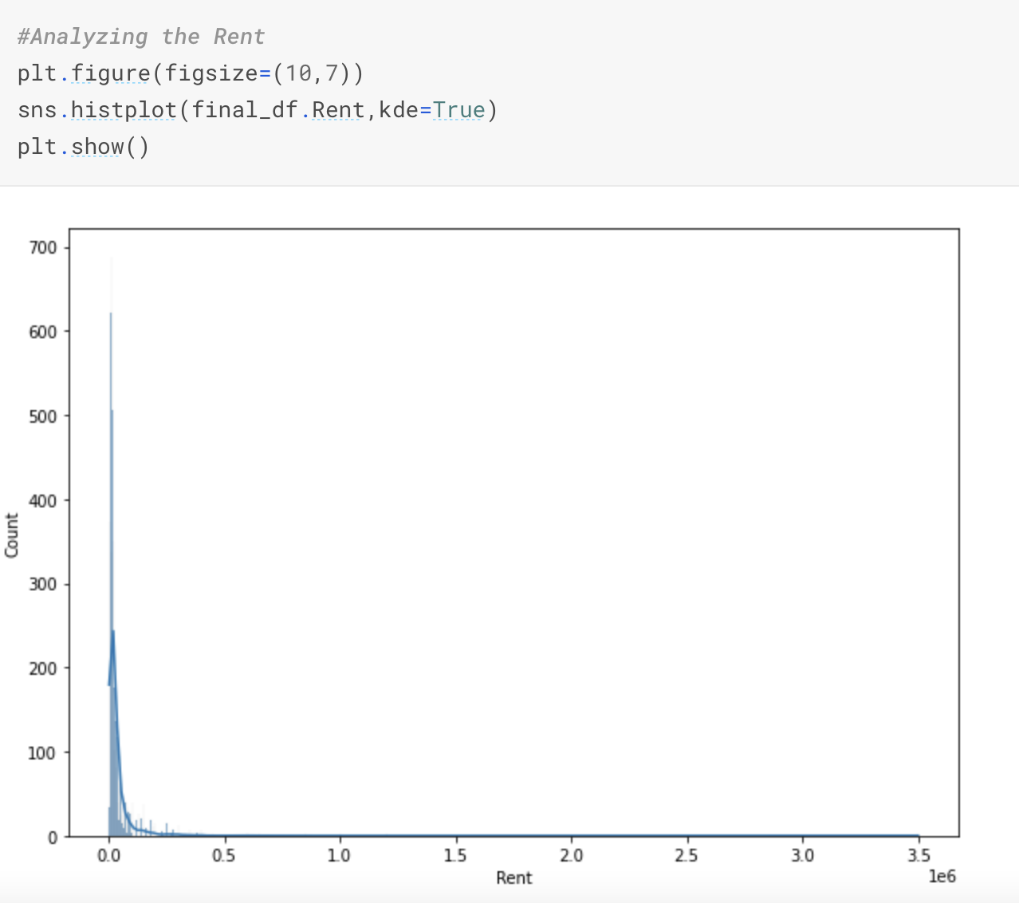
EDA
Show the patterns and anomalies encountered along with the results of the hypothesis tests after conducting the EDA
Also add graphs which helped infer the most information

Slide 13
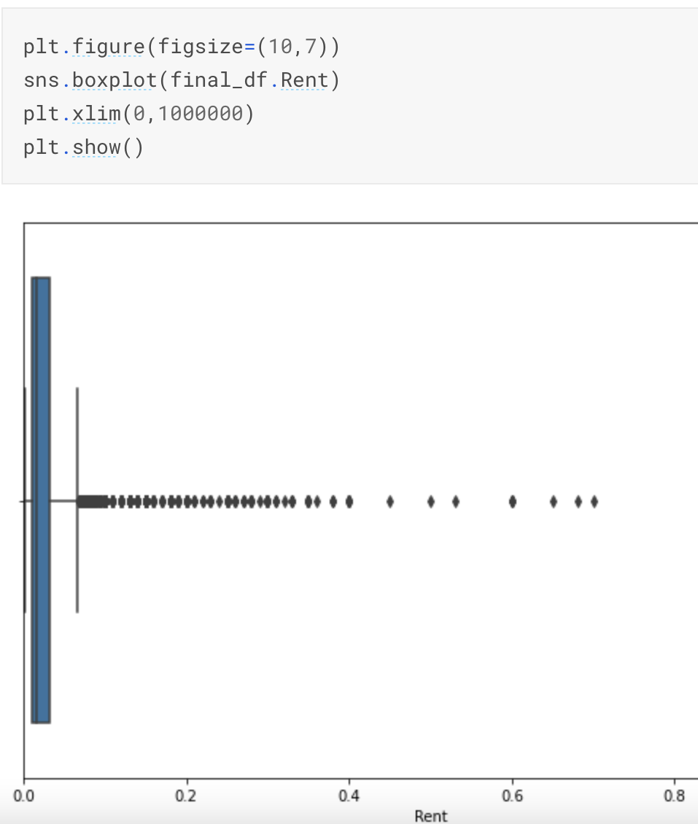
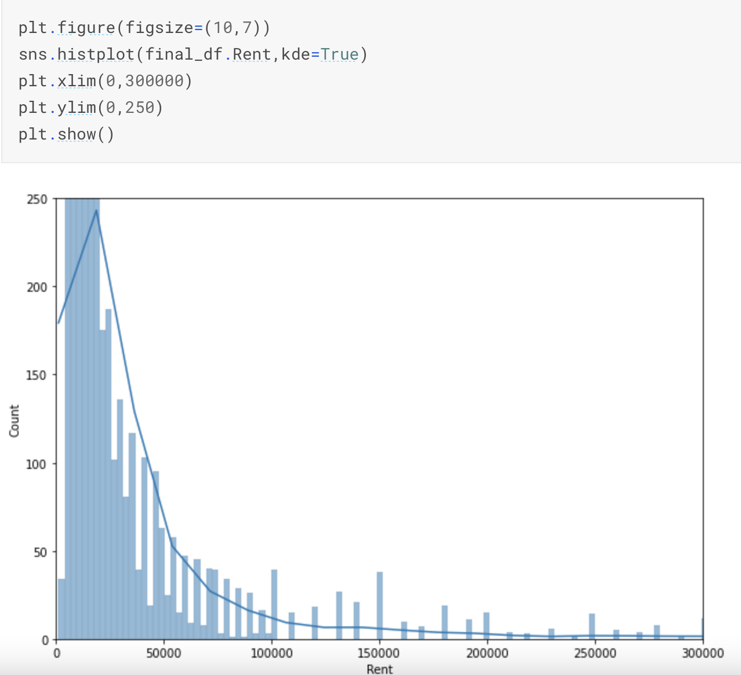

Slide 14
When our original continuous data do not follow the bell curve, we can log transform this data to make it as “normal” as possible so that the statistical analysis results from this data become more valid. In other words, the log transformation reduces or removes the skewness of our original data. It improves linearity between our dependent and independent variables. It boosts validity of our statistical analyses
#We will apply Log Transformation in order to convert Rent into Normal Distribution
final_df['Rent']=np.log1p(final_df['Rent'])

Slide 15

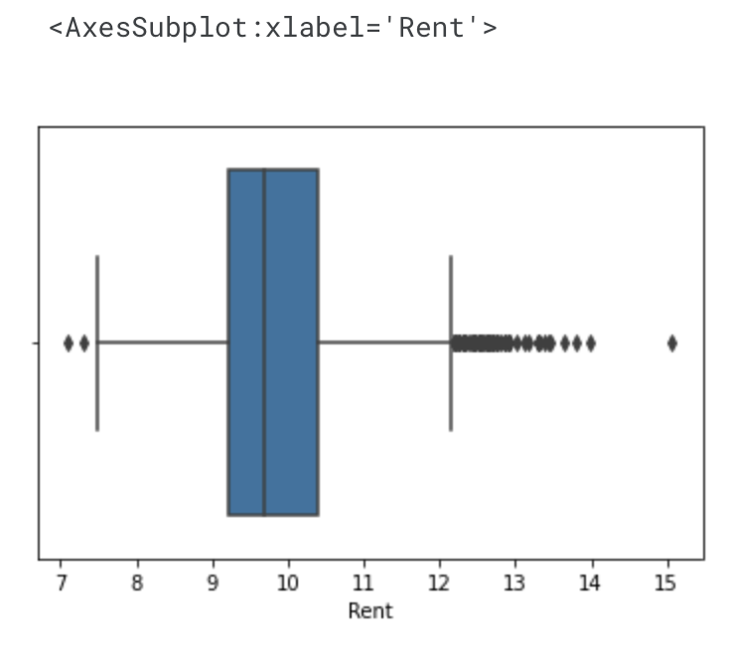
BOX PLOT
sns.boxplot('Rent',data=final_df)

Slide 16
#Analyzing the Posted On column
final_df['Posted On'].nunique()

Slide 17
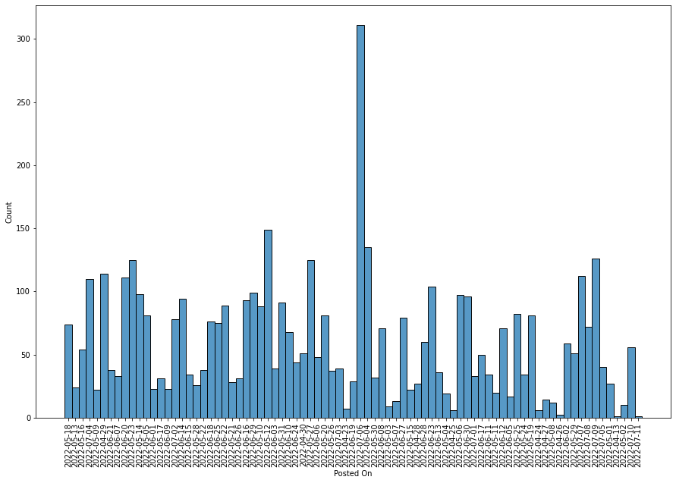
HISTOGRAM
plt.figure(figsize=(15,10))
sns.histplot(final_df['Posted On'])
plt.xticks(rotation='vertical')
plt.show()

Slide 18
#Analyzing the BHK column
final_df.BHK.unique()
Out[17]:
array([2, 1, 3, 6, 4, 5])

Slide 19
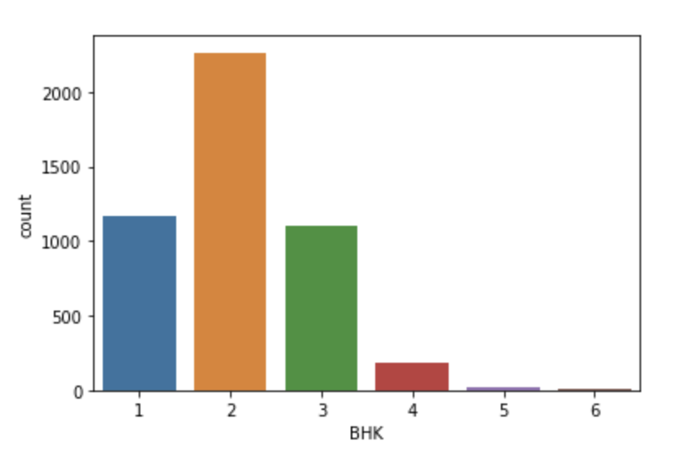
COUNT PLOT
sns.countplot('BHK',data=final_df)
Out[18]:

Slide 20
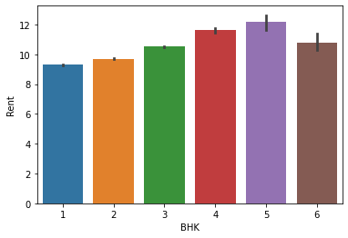
BAR PLOT
sns.barplot(x='BHK',y='Rent',data=final_df)

Slide 21
Observation:
The Average Rent of the 5BHK is the highest compared to all.

Slide 22
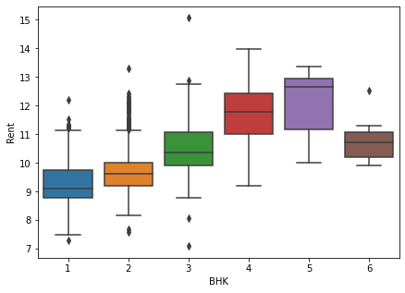
BOX PLOT
plt.figure(figsize=(7,5))
sns.boxplot(x='BHK',y='Rent',data=final_df)
plt.show()

Slide 23
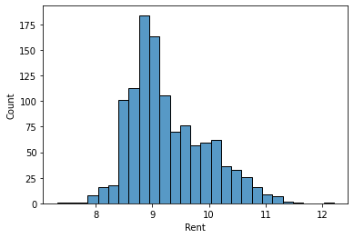
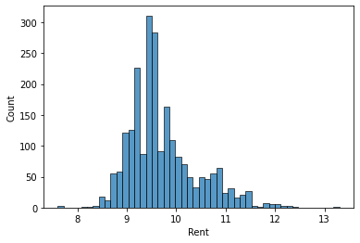
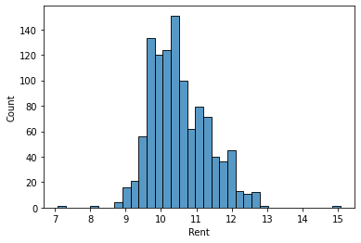
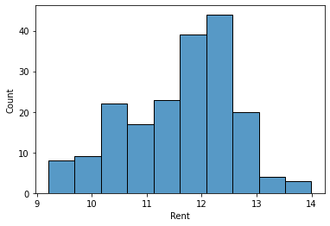
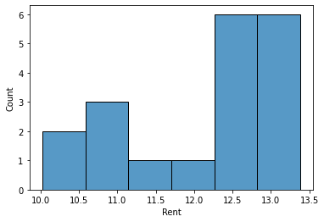
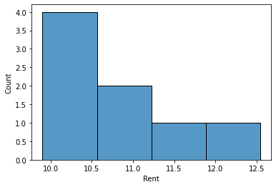
HISTOGRAM AGAIN
for i in range(6):
sns.histplot(final_df[final_df['BHK']==i+1].Rent) plt.show()

Slide 24
Observation:
Each BHK contains a lot of Outliers.
Insights
Will Remove few of them without making the Dataset Thin

Slide 25
#Analyzing the Size column
#Unique values of Size
final_df['Size'].nunique()

Slide 26
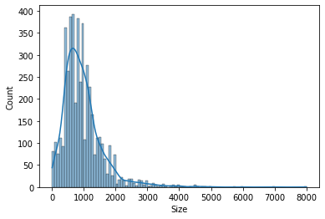
#Distribution of Size column
sns.histplot(final_df.Size,kde=True)

Slide 27
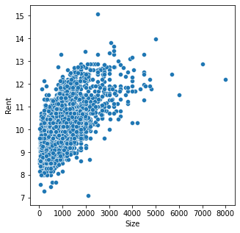
#Distribution of Size column
plt.figure(figsize=(5,5))
sns.scatterplot(x=final_df.Size,y=final_df.Rent)
plt.show()

Slide 28
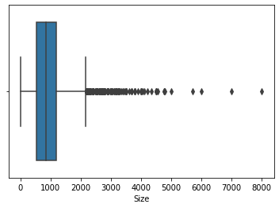
#Distribution of Size column
sns.boxplot('Size',data=final_df)
Out[25]:

Slide 29
Observation:
More the Size of House,More the Rent is
Contains a lot of Outliers.

Slide 30
#Analyzing the Floor Column
final_df.Floor.value_counts()
Out[26]:
1 out of 2 379
Ground out of 2 350
2 out of 3 312
2 out of 4 308
1 out of 3 293
...
11 out of 31 1
50 out of 75 1
18 out of 26 1
12 out of 27 1
23 out of 34 1
Name: Floor, Length: 480, dtype: int64

Slide 31
#Analyzing the Area Type
final_df['Area Type'].value_counts()
Out[27]:
Super Area 2446
Carpet Area 2298
Built Area 2
Name: Area Type, dtype: int64

Slide 32
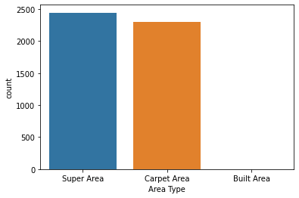
#Analyzing the Area Type
sns.countplot('Area Type',data=final_df)
Out[28]:

Slide 33
Observation:
The no. of Super Area is higher than all of the areas.
Built Area contains only two houses for Rent in the Dataset.

Slide 34
final_df.groupby('Area Type')['Rent'].mean()
Out[29]:
Area Type
Built Area 9.157777
Carpet Area 10.248720
Super Area 9.530714
Name: Rent, dtype: float64

Slide 35
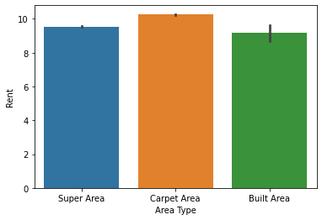
#Analyzing the Area Type
sns.barplot(final_df['Area Type'],y=final_df['Rent

Slide 36
Observation:
Built Area Houses are the Cheapest.
Super Area Houses are cheaper as compared to Carpet Area.

Slide 37
#Analyzing the Area Locality
final_df['Area Locality'].value_counts()
Out[31]:
Bandra West 37
Gachibowli 29
Electronic City 24
Velachery 22
Miyapur, NH 9 22
..
Kengeri Upanagara 1
Ittamadu, Banashankari, Outer Ring Road 1
Rmv Extension, Armane Nagar 1
snv la 1
Manikonda, Hyderabad 1
Name: Area Locality, Length: 2235, dtype: int64

Slide 38
#Analyzing the City Column
final_df['City'].value_counts()
Out[32]:
Mumbai 972
Chennai 891
Bangalore 886
Hyderabad 868
Delhi 605
Kolkata 524
Name: City, dtype: int64

Slide 39
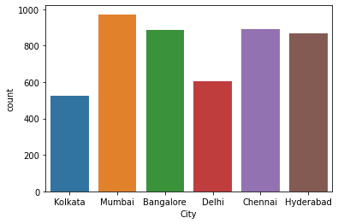
#Analyzing the City Column
sns.countplot(final_df.City)

Slide 40
final_df.groupby('City')['Rent'].mean()
Out[34]:
City
Bangalore 9.634777
Chennai 9.645544
Delhi 9.855434
Hyderabad 9.634704
Kolkata 9.150935
Mumbai 10.937095
Name: Rent, dtype: float64

Slide 41
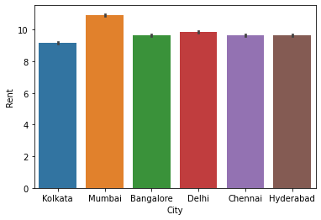
#Analyzing the City Column
sns.barplot('City','Rent',data=final_df)

Slide 42
Observation
The Average Rent of Mumbai House is the Highest than all of the Cities.

Slide 43
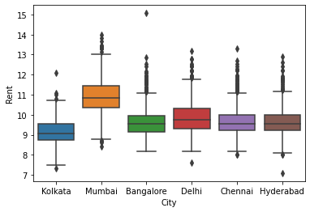
#Analyzing the City Column
sns.boxplot('City','Rent',data=final_df)

Slide 44
#Analyzing the Furnishing Status
final_df['Furnishing Status'].value_counts()
Semi-Furnished 2251
Unfurnished 1815
Furnished 680
Name: Furnishing Status, dtype: int64
50% of the Houses are Semi Furnished.
40% of the Houses are Unfurnished.
Rest of the Houses are Furnished.
final_df.groupby('Furnishing Status')['Rent'].mean()
Furnishing Status
Furnished 10.352446
Semi-Furnished 9.979319
Unfurnished 9.575146
Name: Rent, dtype: float64

Slide 45
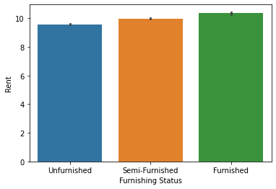
#Analyzing the Furnishing Status
sns.barplot('Furnishing Status','Rent',data=final_df)

Slide 46
#Analyzing the Tenant Preferred
final_df['Tenant Preferred'].value_counts()
Out[40]:
Bachelors/Family 3444
Bachelors 830
Family 472
Name: Tenant Preferred, dtype: int64
In [41]:

Slide 47
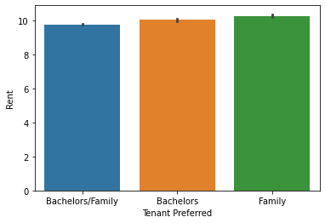
#Analyzing the Tenant Preferred
sns.barplot('Tenant Preferred','Rent',data=final_df)
Out[41]:

Slide 48
#Analyzing the Bathroom Column
final_df['Bathroom'].value_counts()
Out[42]:
2 2291
1 1474
3 749
4 156
5 60
6 12
7 3
10 1
Name: Bathroom, dtype: int64

Slide 49
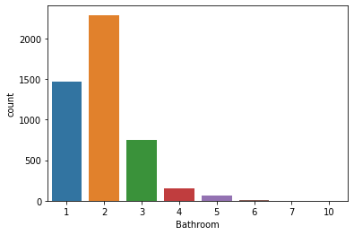
#Analyzing the Bathroom Column
sns.countplot('Bathroom',data=final_df)

Slide 50
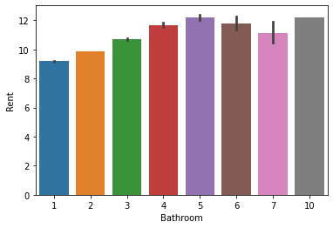
#Analyzing the Bathroom Column
sns.barplot('Bathroom','Rent',data=final_df)
V

Slide 51
#Analyzing the Point of Contact
final_df['Point of Contact'].value_counts()
Out[45]:
Contact Owner 3216
Contact Agent 1529
Contact Builder 1
Name: Point of Contact, dtype: int64

Slide 52
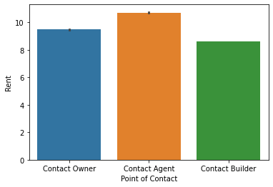
#Analyzing the Point of Contact
sns.barplot('Point of Contact','Rent',data=final_df)

Slide 53

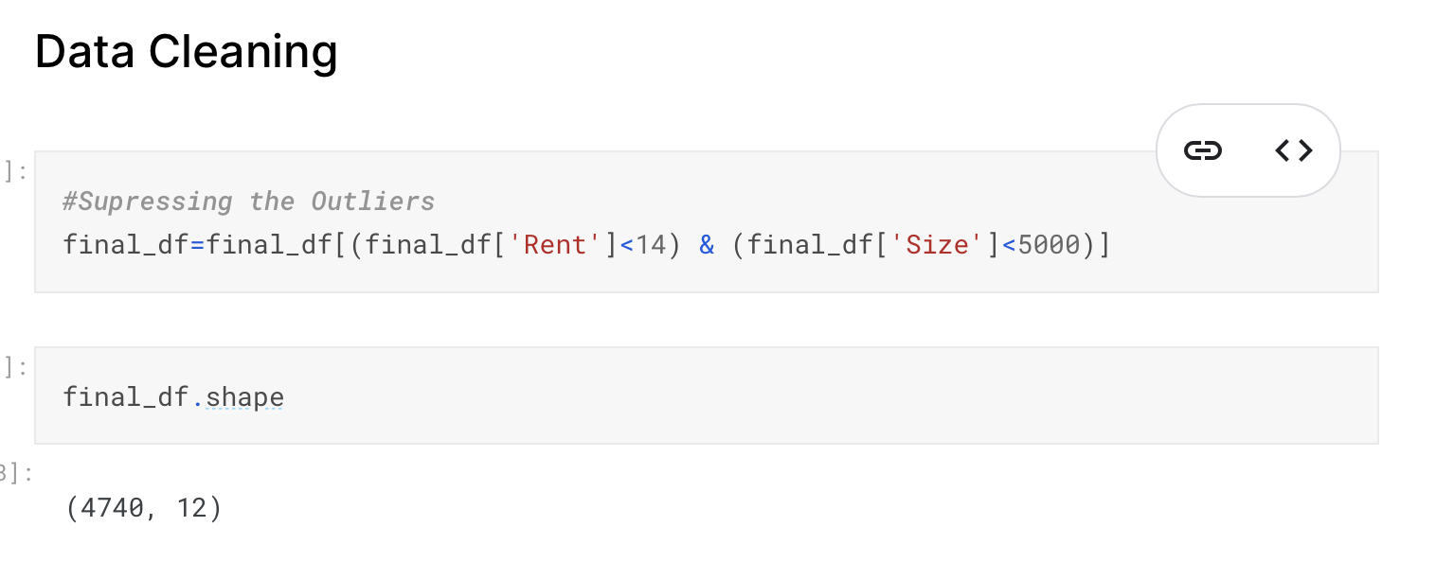

More than 50 million Americans travelled abroad in 2015
THAT’S MORE THAN THE POPULATION OF
CALIFORNIA AND TEXAS COMBINED
Tip
When a number is too large or too small to easily comprehend, clarify it with a comparison to something familiar.

Slide 54
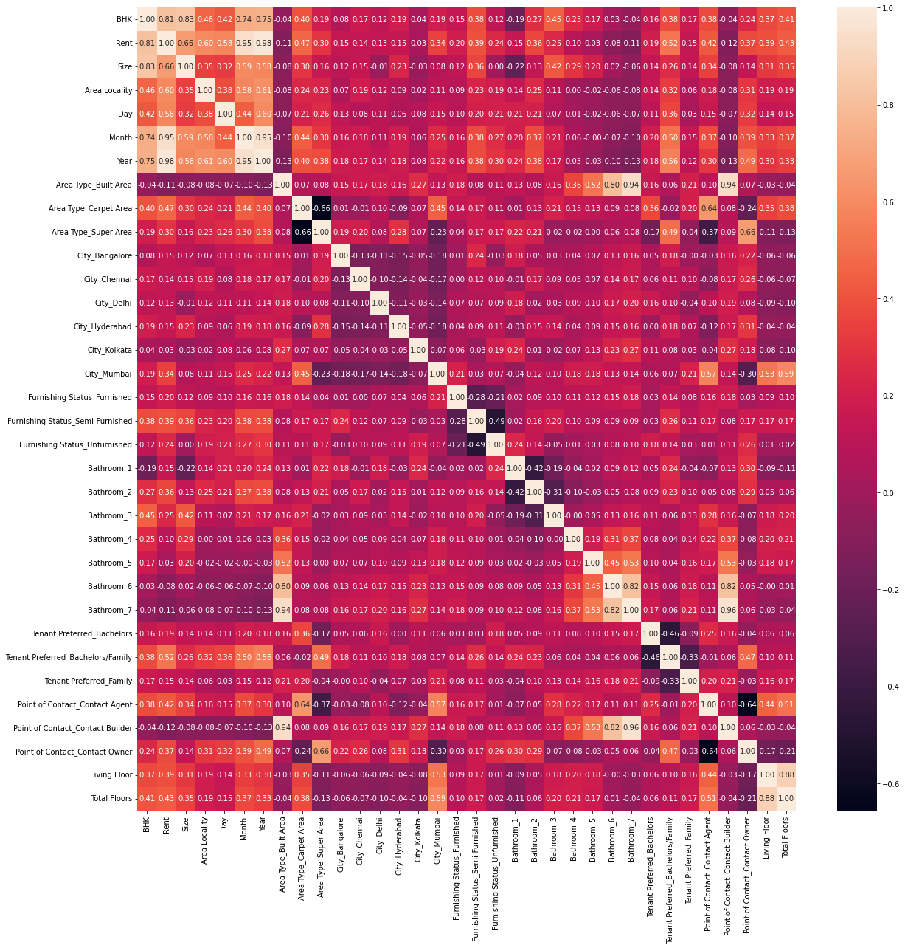
#Correlation between all Features
plt.figure(figsize=(20,20))
sns.heatmap(final_df.corr(),annot=True,fmt='.2f')
plt.show()

Slide 55
#Dropping these Features in order to Reduce the Problem of Multi-Collinearity
final_df.drop('Living Floor',axis=1,inplace=True)
final_df.drop('Point of Contact_Contact Builder',axis=1,inplace=True)
final_df.drop('Bathroom_6',axis=1,inplace=True)
final_df.drop('Bathroom_7',axis=1,inplace=True)
final_df.drop('Month',axis=1,inplace=True)

Slide 56
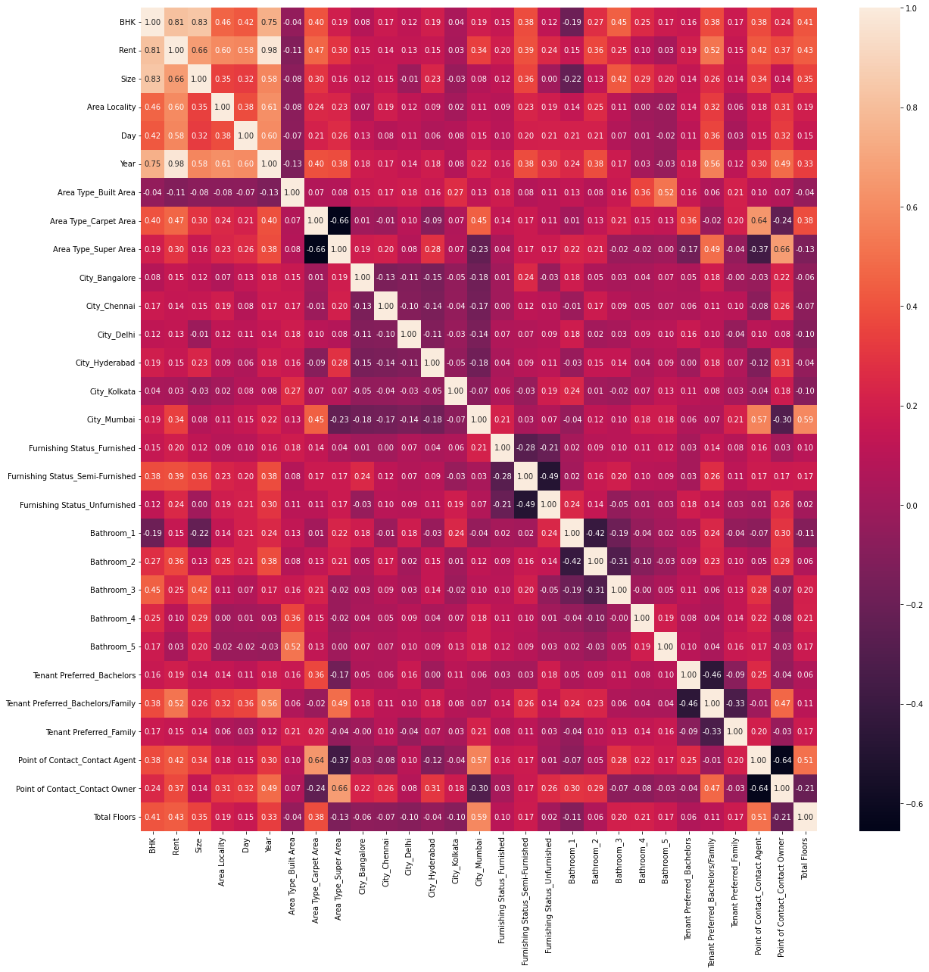
#Correlation between all Features
plt.figure(figsize=(20,20))
sns.heatmap(final_df.corr(),annot=True,fmt='.2f')
plt.show()

Slide 57
Splitting of Train and Test Data
In [67]:
X=final_df.drop('Rent',axis=1)
y=final_df['Rent']
# Train-Test Split
X_train,X_test,y_train,y_test=train_test_split(X,y,test_size=0.2,random_state=42)
ss=StandardScaler()
X_train=ss.fit_transform(X_train)
X_test=ss.transform(X_test)

Slide 58
Modelling
models = {
'Linear' : LinearRegression(),
'ridge' : Ridge(),
'xgboost' : XGBRegressor(),
'catboost' : CatBoostRegressor(verbose=0),
'lightgbm' : LGBMRegressor(),
'gradient boosting' :
GradientBoostingRegressor(),
'lasso' : Lasso(),
'random forest' : RandomForestRegressor(),
'bayesian ridge' : BayesianRidge(),
'support vector': SVR(),
'knn' : KNeighborsRegressor(n_neighbors = 4)

Slide 59
#Training Different Models
for name, model in models.items():
model.fit(X_train, y_train)
print(f'{name} trained')
Linear trained
ridge trained
xgboost trained
catboost trained
lightgbm trained
gradient boosting trained
lasso trained
random forest trained
bayesian ridge trained
support vector trained
knn trained

Slide 60
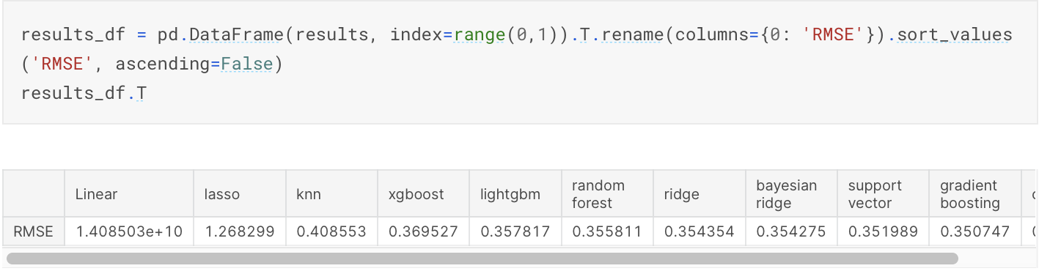
Evaluating the Models
results = {}
kf = KFold(n_splits= 10)
for name, model in models.items():
result = np.mean(np.sqrt(-cross_val_score(model, X_train, y_train,scoring='neg_mean_squared_error', cv= kf)))
results[name] = result
In [71]:
for name, result in results.items():
print(f"{name} : {round(result, 3)}")
Linear : 14085033618.791
ridge : 0.354
xgboost : 0.37
catboost : 0.331
lightgbm : 0.358
gradient boosting : 0.351
lasso : 1.268
random forest : 0.356
bayesian ridge : 0.354
support vector : 0.352
knn : 0.409

Slide 61
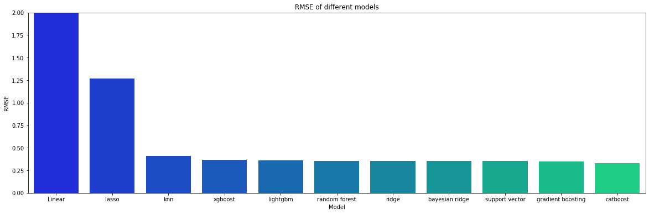
RMSE OF DIFFERENT MODELS
plt.figure(figsize = (20, 6))
sns.barplot(x= results_df.index, y = results_df['RMSE'], palette = 'winter')
plt.ylim(0,2)
plt.xlabel('Model')
plt.ylabel('RMSE')
plt.title('RMSE of different models');

Slide 62
#Defining the Method in order to get the r2_score of each Model on Test Data and Based
# on that,We will select our Model
def prediction(model,X_train,y_train,X_test,y_test):
model.fit(X_train,y_train)
pred_data=np.exp(model.predict(X_test))
return r2_score(np.exp(y_test),pred_data)

Slide 63
for name,model in models.items():
score=prediction(model,X_train,y_train,X_test,y_test)
print(f'{name} r2_score is {score}')
Linear r2_score is 0.667356035807981
ridge r2_score is 0.6687001695717816
xgboost r2_score is 0.6782093439768724
catboost r2_score is 0.6699485536735215
lightgbm r2_score is 0.7130113622736785
gradient boosting r2_score is 0.6798962425510935
lasso r2_score is -0.03677438959812562
random forest r2_score is 0.6894787273883622
bayesian ridge r2_score is 0.6689207974172564
support vector r2_score is 0.6502212669411573
knn r2_score is 0.5753463137414174

Slide 64
LIGHT GBM
#Lightgbm is giving the r2_score of more than 0.71
#Hence,We Select the LightGBM
#Light GBM is a fast, distributed, high-performance gradient boosting framework
#based on decision tree
algorithm, used for ranking, classification and many other machine learning tasks.
Quotes for illustration purposes only

Slide 65
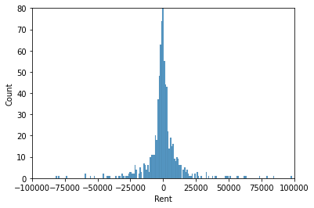
#Error of the Predicted Y with the True Y
model=LGBMRegressor()
model.fit(X_train,y_train)
pred_y=np.exp(model.predict(X_test))
sns.histplot(np.exp(y_test)-pred_y)
plt.xlim(-100000,100000)
plt.ylim(0,80)
plt.show()

Slide 66

APPLYING VOTING ENSEMBLE ON THE 3 MODELS
pred_y=vc.predict(X_test)
print(r2_score(np.exp(y_test),np.exp(pred_y)))
RESULT AFTER FITTING THE MODEL
0.7055323932185411

Slide 67
APPLYING VOTING ENSEMBLE ON THE 3 MODELS
RESULT OF VOTING→
0.99
from sklearn.ensemble import VotingRegressor
estimators=[('rf',RandomForestRegressor()),('CB',CatBoostRegressor(verbose=0)),('lgbm',LGBMRegressor())]
vc=VotingRegressor(estimators=estimators)
x=cross_val_score(vc,X_train,y_train,cv=10,scoring='r2')
print(np.round(np.mean(x),2))

Slide 68
FITTING THE MODEL
VotingRegressor(estimators=[('rf', RandomForestRegressor()),
('CB',
<catboost.core.CatBoostRegressor object at 0x7f3151473390>),
('lgbm', LGBMRegressor())])
vc.fit(X_train,y_train)

Slide 69
FITTING THE MODEL
RESULT OF FITTING THE MODEL→
0.7055323932185411
pred_y=vc.predict(X_test)
print(r2_score(np.exp(y_test),np.exp(pred_y)))

